Slide 1
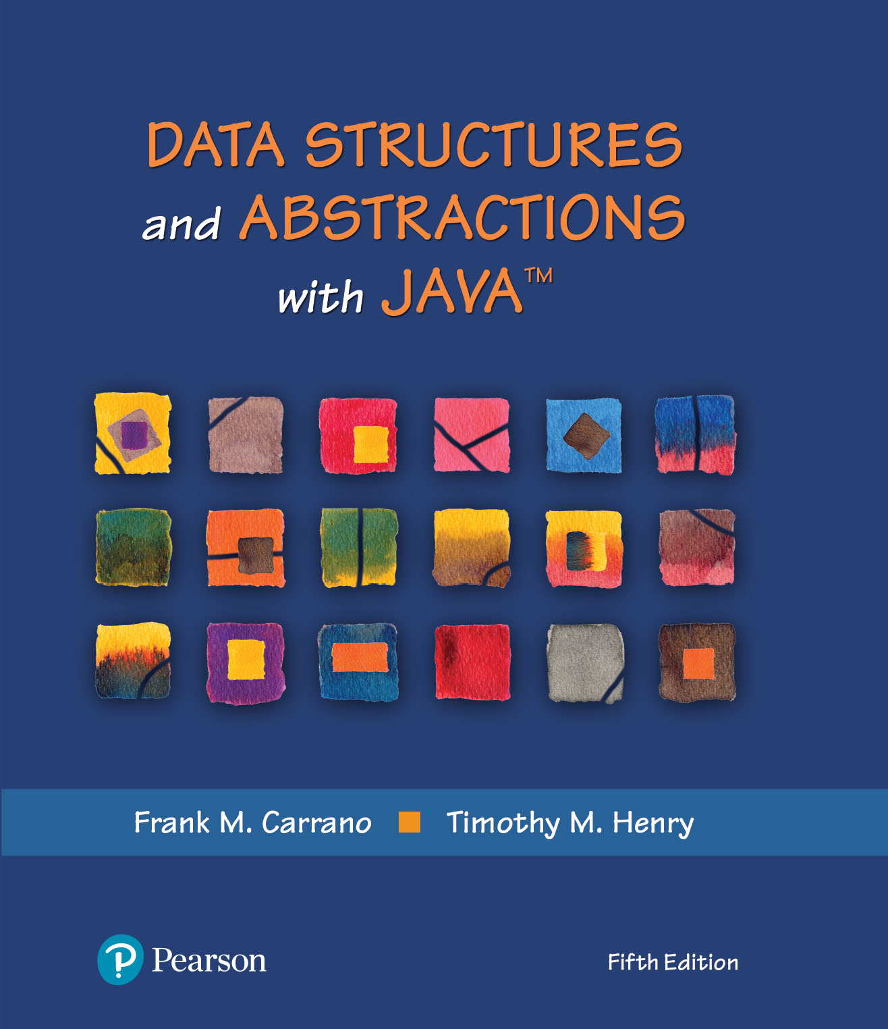
Module 17 – Advanced I/O & Object Streams

Slide 2
Additional Resources
JoshDoesJava
Binary Files Lesson - Java
https://www.youtube.com/watch?v=AIl3N_eSY8Y
Random Access Files Lesson - Java
https://www.youtube.com/watch?v=idhFXfdp_Mw
Java Text File I/O Introduction
https://www.youtube.com/watch?v=yO_ctH4mEk4
Notes:
Watch Creating a Binary Tree (twice)

Slide 3
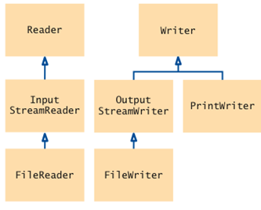
Text File (Human-Readable, ASCII)
Sequence of characters
12345 stored as ASCII characters '1' '2' '3' '4' '5'
Use Reader and Writer and their subclasses to process input and output
Reader and Writer classes are responsible for converting between bytes and characters
Notes:
We have done this in 203

Slide 4
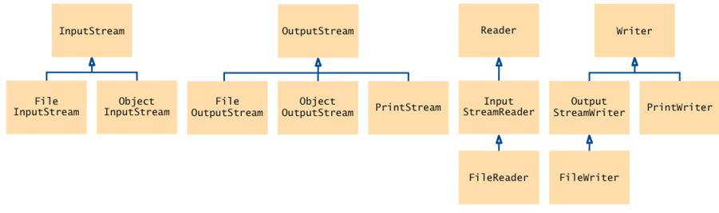
Input / Output Classes
Binary (Data) files
Text files
Sample binary data files (Word doc, PDF)
Notes:
File vs. Object

Slide 5
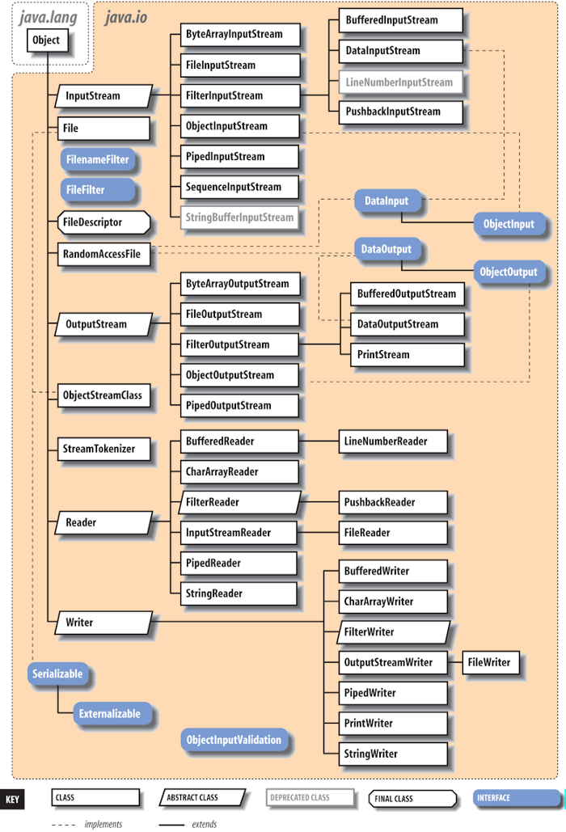
Hierarchy of I/O Class in Java
Notes:
https://medium.com/geekculture/must-know-java-concepts-files-io-3a58399f2b80

Slide 6
Binary vs. Text Files
Text (ASCII) Files
Binary (Data) Files
Data items are represented in bytes
Integer value, 12345, stored as a sequence of four bytes
0 0 48 57
Because 12,345 = 48 * 256 + 57
Why do we care?
More compact and more efficient. Use InputStream and OutputStream and their subclasses
Notes:
ASCII (Text) Files – can be opened using Notepad

Slide 7
Decimal, Hex vs. Bytes
Decimal Number
122 = 1*10^2 + 2*10^1 + 2
Hex
0x7A = 7*16^1 + A
Bytes
122
Another Example
20,000 = ???
References
https://calculator.name/baseconvert/decimal/hexadecimal/122
https://mkyong.com/java/java-convert-byte-to-int-and-vice-versa/
Notes:
20000 in Hex
20000 in Bytes
78 32

Slide 8
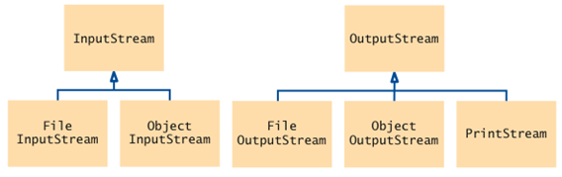
InputStream & OutputStream
Responsible for input and output of bytes
Notes:
0 0 78 32

Slide 9
Exchanging Data | Latest Trends
Text (ASCII)
JSON
Binary
Pros vs. Cons

Slide 10
Binary | Read
To read
FileInputStream inputStream =
new FileInputStream("input.dat");
Use read method of InputStream class to read a single byte
returns the next byte as an int
or the integer -1 at end of file
InputStream in = . . .;
int next = in.read();
byte b;
if (next != -1)
b = (byte) next;
Example
11C-advanced-file-io
read_binary_file()
read_allBytes()
Notes:
https://docs.oracle.com/javase/7/docs/api/java/io/InputStream.html
https://docs.oracle.com/javase/8/docs/api/java/nio/file/Files.html

Slide 11
Binary | Write
To write:
FileOutputStream outputStream =
new FileOutputStream("output.dat");
Use write method of OutputStream class to write a single byte:
OutputStream out = . . .;
byte b = . . .;
out.write(b);
When you are done writing to the file, close it
out.close();

Slide 12
The read() Method
Why does the read() method of the InputStream class return an int and not a byte?
It returns a special value of –1 to indicate that no more input is available
If the return type had been byte, no special value would have been available that is distinguished from a legal data value
Resources
https://www.codejava.net/java-se/file-io/how-to-read-and-write-binary-files-in-java
https://developer.ibm.com/tutorials/j-nio/
Notes:
Nam Ha Minh

Slide 13
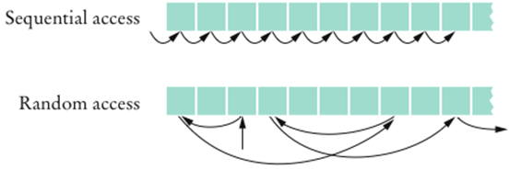
Random vs. Sequential File Access
Sequential access
A file is processed a byte at a time
It can be inefficient
Random access
Allows access at arbitrary locations in the file
Only disk files support random access
System.in and System.out do not
Each disk file has a special file pointer position
You can read or write at the position where the pointer is

Slide 14
Random Access File
You can open a file either for
Reading only (“r”)
Reading and writing (“rw”)
RandomAccessFile f = new RandomAcessFile("bank.dat","rw");
To move the file pointer to a specific byte:
f.seek(n);
To get the current position of the file pointer:
long n = f.getFilePointer(); // type "long" because files can be very large
To find the number of bytes in a file:
long fileLength = f.length();

Slide 15



A Sample Program
Use a random access file to store a set of bank accounts
Program lets you pick an account and deposit money to it
To manipulate a data set in a file, pay special attention to data formatting
Suppose we store the data as text
Say account 1001 has a balance of $900, and account 1015 has a balance of 0
What options do we have?
We want to deposit $100 into account 1001
If we now simply write out the new value, the result is
Notes:
Why are we doing this?

Slide 16
A Sample Program
Better way to manipulate a data set in a file:
Give each value a fixed size that is sufficiently large
Every record has the same size
Easy to skip quickly to a given record
To store numbers, it is easier to store them in binary format

Slide 17
Bank Example (1 of 4)
Execute provided bank-example (12B-example-bank)
Deposit an amount of your choice to an account
Rerun program and make an additional deposit to the same account
It should work just fine
Modify it to support both deposit and withdraw transactions
RandomAccessFile class stores binary data
readInt and writeInt read/write integers as four-byte quantities

Slide 18
Bank Example (2 of 4)
readDouble and writeDouble use 8 bytes:
double x = f.readDouble();
f.writeDouble(x);
To find out how many bank accounts are in the file:
public int size() throws IOException { return (int) (file.length() / RECORD_SIZE); // RECORD_SIZE is 12 bytes: // 4 bytes for the account number and // 8 bytes for the balance }

Slide 19
Bank Example (3 of 4)
To read the n^{th} account in the file:
n is the index
public BankAccount read(int n) throws IOException {
// move file pointer to correct position file.seek(n * RECORD_SIZE);
// read in accountNumber int accountNumber = file.readInt();
// read in balance double balance = file.readDouble();
// create a new BankAccount using this data return new BankAccount(accountNumber, balance); }

Slide 20
Bank Example (4 of 4)
To write the n^{th} account in the file:
public void write(int n, BankAccount account) throws IOException {
//move file pointer to correct position file.seek(n * RECORD_SIZE);
// write the account number file.writeInt(account.getAccountNumber());
// write the balance file.writeDouble(account.getBalance()); }

Slide 21
Advantage vs. Disadvantage
Binary (random access) file format for storing numbers
Advantage
Numbers use a fixed amount of storage space, making it possible to change their values without affecting surrounding data
Potential disadvantage
Cannot read a binary file with a text editor

Slide 22
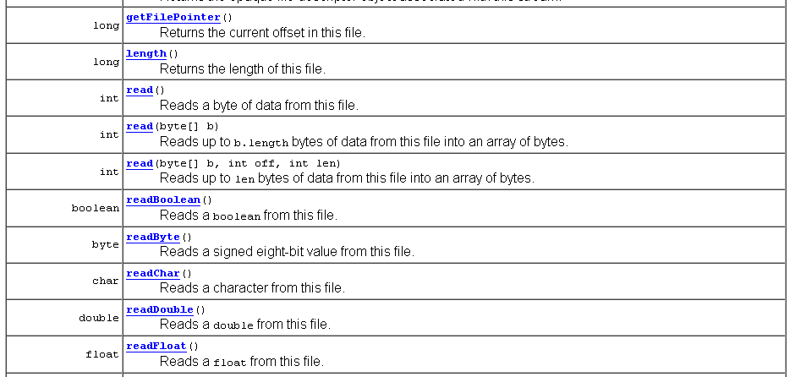
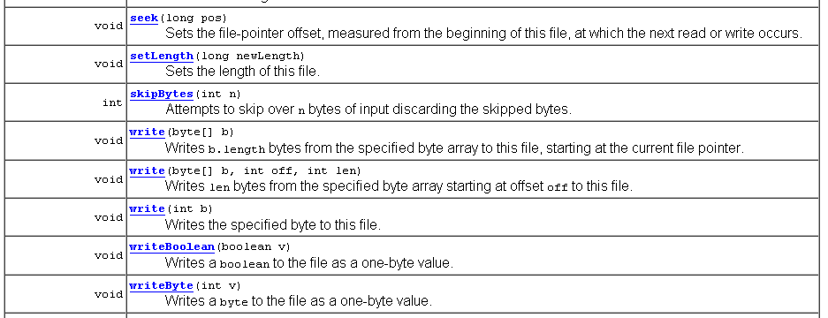
Notes:
https://docs.oracle.com/javase/8/docs/api/java/io/RandomAccessFile.html
Class RandomAccessFile

Slide 23
Object Streams
ObjectOutputStream class can save an entire objects to disk
ObjectInputStream class can read objects back in from disk
Objects are saved in binary format; hence, you use streams

Slide 24
Writing BankAccount Object to File
The object output stream saves all instance variables:
BankAccount b = ...; ObjectOutputStream out =
new ObjectOutputStream(new FileOutputStream("bank.dat"));
out.writeObject(b);

Slide 25
Reading Object from File (Bank Account)
readObject returns an Object reference
Need to remember the types of the objects that you saved and use a cast:
ObjectInputStream in = new ObjectInputStream(new
FileInputStream("bank.dat"));
BankAccount b =(BankAccount) in.readObject();
readObject method can throw a ClassNotFoundException
It is a checked exception - you must catch or declare it

Slide 26
bank-serialize Example
Run provided bank-serialize (13B-example-bank-serialize)
What did you notice and what have you learned?
Random access vs. serialized?

Slide 27
Write & Read an ArrayList to a File
Write
ArrayList<BankAccount> a = new ArrayList<BankAccount>();
// Now add many BankAccount objects into a file
out.writeObject(a);
Read
ArrayList<BankAccount> a =
(ArrayList<BankAccount>) in.readObject();
You are processing the entire array

Slide 28
Serializable
This is the writeObject for the ArrayList class:
private void writeObject(ObjectOutputStream s) throws IOException
{
// Write out element count (size of ArrayList)
s.defaultWriteObject();
// Write out array length (which holds the elements – elementData)
s.writeInt (elementData.length)
//Write out all elements in the proper order
for(int i=0; i<size; i++)
s.writeObject(elementData[i]);
}

Slide 29
Serializable
You have created an ArrayList called names whose elements are of type String. Write names to a binary file using ObjectOutputStream
try
{
ObjectOutputStream oos = new ObjectOutputStream(new FileOutputStream(“names.dat”);
oos.writeObject(names);
}
catch (IOException e)
{
System.out.println(e);
}
Read from the file back into an ArrayList:
try
{
ObjectInputStream ois = new ObjectInputStream(new FileInputStream(“names.dat”);
names = (ArrayList<String>)ois.readObject();
}
catch (IOException e)
{
System.out.println(e);
}

Slide 30
Serializable | Serialization
Process of saving objects to a stream
Objects that are written to an object stream must implements the Serializable interface:
class BankAccount implements Serializable { ... }
Serializable interface has no methods
All Collection classes in the Java Collections Framework implement the Serializable Interface
Provides information to the Java virtual machine about sending instances of the class to/from a stream (a sequence of bytes)
Any class that implements Serializable will be able to copy any object of the class to an output stream – that is to “serialize” the elements in the object
“Deserialization” reconstructs the original object from a stream
Provides a writeObject method

Slide 31
Serializable
Why is it easier to save an object with an ObjectOutputStream than a RandomAccessFile?
You can save the entire object with a single writeObject call. With a RandomAccessFile, you have to save each instance variable separately
To make your own classes serializable:
Implement Serializable
Don’t need to define the writeObject and readObject methods If all that is saved is fields
Otherwise, must define these methods (such as traversing a tree)

Slide 32
Serializing a Binary Tree
How do you save the tree object (to a file)?
More importantly, how do you deserialize it?
A
B
C
D
E
F
G

Slide 33
Serializing a Binary Tree
Try it – Print out nodes, in order that they would appear in a pre-order traversal
Why doesn’t this work?
A
B
C
D
E
F
G
We will NOT be able to recreate the above tree, in reversed
A B D E G C F
Notes:
How do you recreate the above tree, given → A B D E G C F

Slide 34
Serializing a Binary Tree
Why not? because we don’t know when we’ve hit a null pointer
We need to store null pointers as well
A
B
C
D
E
F
G
A B D / /E G / / / C / F / /
Notes:
Array based implementation of a tree

Slide 35
Serializing a Binary Tree
What would the tree look like with this representation?
ABDE//G///CF/H///

Slide 36
Serializing a Binary Tree
What would the tree look like with this representation?
ABDE//G///CF/H///
A
B
C
D
F
E
G
H

Slide 37
ABDE//G///CF/H///
1A1B1D1E001G0001C1F01H000
Read an int
If a 1 then data follows it, read the data
If a 0, represents a null

Slide 38
private void writeObject(ObjectOutputStream out) throws IOException
{
if (root != null)
tree_FileWrite(root, out);
}
private void tree_FileWrite(Node r, ObjectOutputStream out)throws IOException
{
if(r != null)
{
//recursive function that uses preorder to write the data of the nodes to the file
// first write out the data of this node
out.writeInt(1); // means a node will follow
out.writeObject(r.data); // String implements serializable
// then write out nodes to the left and then nodes to the right
tree_FileWrite(r.left,out);
tree_FileWrite(r.right,out);
}
else out.writeInt(0);// this will represent a null in the tree
}

Slide 39
private void readObject(java.io.ObjectInputStream in)throws IOException, ClassNotFoundException
{
root = new Node();
tree_FileRead(root, in);
}
private Node tree_FileRead(Node r, ObjectInputStream in)throws IOException, ClassNotFoundException
{
int n = in.readInt();
if(n != 0)
{
if(r != root)
r = new Node();
r.data = (String)in.readObject();
r.left = tree_FileRead(r.left,in);
r.right = tree_FileRead(r.right,in);
}
else r = null;
return r;
}
Notes:
https://www.educative.io/m/serialize-deserialize-binary-tree
https://www.baeldung.com/java-binary-tree
https://www.baeldung.com/java-print-binary-tree-diagram

